Slide 2
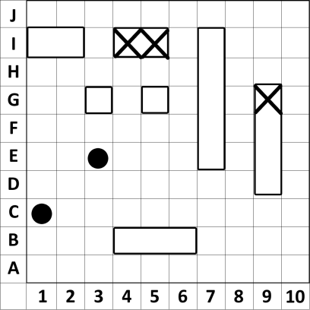
1.5 Sea Battle
Objectives
The participants learn to construct different rectangles (the width is always 1; the length is 1, 2, 3, 4 and 5.
The students learn to use game coordinates, like 3B.
The students learn to use mathematical coordinates, like (3|2).
Tools, Materials and Organisation
Each of the two players needs two empty grids: one for to mark his own ships and one for to mark the hits own and on the enemy ships.
The lesson takes 45 minutes.

Slide 3
1.5 Sea Battle
Player 1
Player 2

Slide 4
1.5 Sea Battle
Player 1
Player 2

Slide 5
1.5 Sea Battle
Player 1
Player 2

Slide 6
1.5 Sea Battle
Player 1
Player 2

Slide 7
1.5 Sea Battle
Player 1
Player 2

Slide 8
1.5 Sea Battle
Player 1
Player 2

Slide 9
1.5 Sea Battle
Description of the Lesson
First part of the lesson (preparation for 5 minutes)
Make groups of two participants. Each player has pencil and several pairs of grids.
Each player is marking his own ships on one of the grids (1st picture).
Second part of the lesson (game 25 minutes)
One player begins shooting by saying the coordinates.
The other player is marking the shots on his grid and is saying: water or hit
If one ship is full of hits, the player has to say: ship has sunk
Go on as long as all ships of one player have sunk.
Third part of the lesson (15 minutes)
Hand out the worksheets to each person one.
Follow the instruction on the worksheet.
If there is enough time, you can go back to the game.

Slide 10
1.5 Sea Battle
Useful Hints
You can do area calculations of rectangles by counting squares and/or calculating area=length*width.
There are computer versions available, where you can play “Sea Battle” alone against the computer:
http://de.battleship-game.org/
http://en.battleship-game.org/
http://es.battleship-game.org/

Slide 11
1.5 Sea Battle
What is a grid?
A grid is a geometric background with the following characteristics:
There are horizontal and vertical lines. All lines have the same distance from each other.
Complete the grid on the left side!
Give each column a number from 1 to 10 and each row a letter from A to J (this is a 10 x 10 grid).
Try to locate the field 2D (column 2, row D) = (2|D) and mark more fields: (1|A), (10|C), (10|J), (5|J)
Definition: (2|D) are the game coordinates of the field in column 2 and row D.

Slide 12
1.5 Sea Battle
In Mathematics not the fields, but the lines and its crossing-points are marked.
Coordinate System on the left side with P(3|2)
Definition: (3|2) are the math. co-ordinates of the crossing point of column-line 3 and row-line 2.
Mathematical notation: P(3|2)
Put more points into the math. co-ordinate system and add the mathematical notation!
A(1|1)
B(14|1)
C(12|5)
D(10|18)
P(3|2)

